Slide 1
States of Precarity
A roundtable discussion

Slide 2
Introducing the States of Precarity project
Precarious working arrangements are increasingly common across the sector and discipline of Geography
HESA statistics estimate that 38% of UK academic staff were employed on fixed-term contracts 2021/22
UCU (2021) estimate that one third of UK academics are employed on fixed-term contracts
Percentage of disabled staff on fixed-term and hourly-paid contracts has increased (UCU 2023)
‘Casualised academic labour has emerged as a defining feature of higher education provision’ (Mason & Megoran 2021)
Impacts career and personal development, health, personal life and relationships (Burton & Bowman 2022; Hughes 2021; Zielke et al. 2023)
Notes:
Precarious working: arrangements may involve, but are not necessarily limited to: short-term contracts; fixed-term contracts; part-time contracts; the requirement to move and be mobile; and long probation periods

Slide 3
Introducing the States of Precarity project
Team: Rachael Squire, Johanne Bruun, Rachel Colls, James Esson, Peter Forman, Anna Jackman
Scope: Project explores the complex landscape of precarious work in UK academic Geography, including:
What precarity is, and how it is experienced
Causes and contributing factors
Geographical dimensions of precarity
Consequences of precarity
Opportunities and best practices for responding to, and intervening in, precarity
Activities: Engaging UK geography departments through surveys and focus groups
Aims:
To understand how precarity is currently experienced within UK geography departments
To develop best-practice guidelines for UK geography departments
Funding: RGS Small Research Grant; Antipode Right to the Discipline Grant
Website: https://www.statesofprecarity.co.uk/
Notes:
Our knowledge of the experiences and effects of precarious working arrangements on individuals and their impacts on academic work cultures is currently limited.
Addressing gaps in knowledge about precarity as it touches down in the discipline of Geography is vital if we are to better understand the effects of precarious working on the discipline, and if we are to work towards better working conditions for those experiencing precarity in academia.
States of Precarity is a research project that will explore the varied effects of precarity in UK academic Geography. Working in collaboration with the Royal Geographical Society (with the Institute for British Geographers), the project seeks to better understand the immediate and long term effects of precarity on staff, research postgraduates, and those who have chosen to leave academia; to provide a snapshot of the far-reaching implications of workplace precarity on the discipline; and to inform the development of best practice guidelines for UK Geography Departments.
States of Precarity is a research project that will explore the varied effects of precarity in UK academic Geography. Working in collaboration with the Royal Geographical Society (with the Institute for British Geographers), the project seeks to better understand the immediate and long term effects of precarity on staff, research postgraduates, and those who have chosen to leave academia; to provide a snapshot of the far-reaching implications of workplace precarity on the discipline; and to inform the development of best practice guidelines for UK Geography Departments.
Project activities include: seeking to engage geography departments across the UK through a survey and focus groups to understand the immediate and lasting effects of precarity on academic geographers, as well as to inform the development of best-practice guidelines for geography departments.
Causes and consequences: including immediate and long-term effects, diverse experiences (e.g. intersectional identities), experiences across career stages
Geographical dimensions of precarity, as it touches down in the discipline

Slide 4
The survey
Ran July - Oct 2023
Sought a snapshot of the far-reaching implications of workplace precarity on the discipline
Open to responses from those working (or having worked) in UK geography - from PhD students to Professors
Wide-ranging questions: Understandings of precarious employment, impacts/experiences of fixed-term contracts, perceptions of precarious work, institutional practice, leaving
Initially run generated 323 responses
Reopened to collect more responses from physical geographers and geographers from a wider range of ethnic backgrounds
Final number of cases: 364
Extremely rich qualitative data
Relatively small sample size for inferential statistics, but…

Slide 5
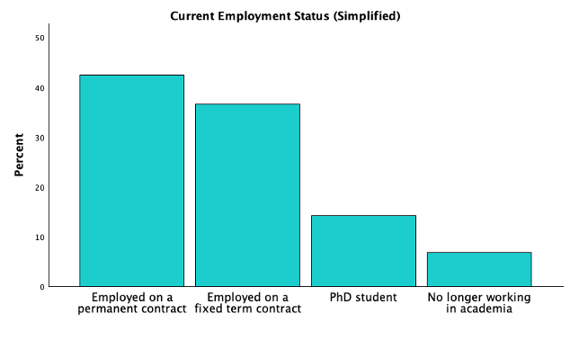
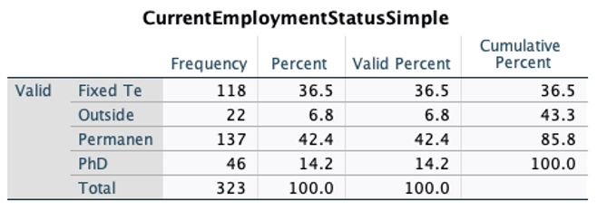
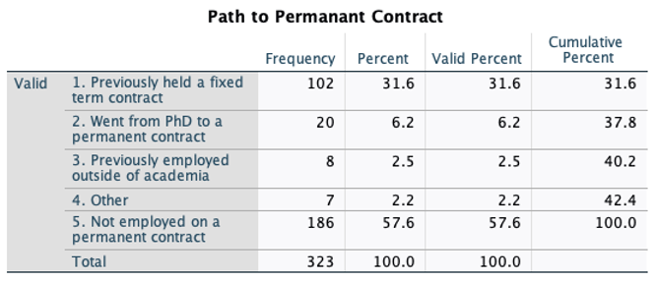
Survey Data:
Sample Demographics
Simplified Contract Types and Pathways to Permanence
Note: Findings presented here are based on initial dataset (323 cases) - analysis on the complete data forthcoming.
Quick Takeaways:
Fairly even balance between respondents currently employed on fixed term and permanent contracts
Marginally more respondents were currently employed on permanent contracts
Speaking of their previous experience? - 74.54% of respondents who are currently employed on a permanent contract have previously held a fixed term position (102 out of 137).
But also…

Slide 6
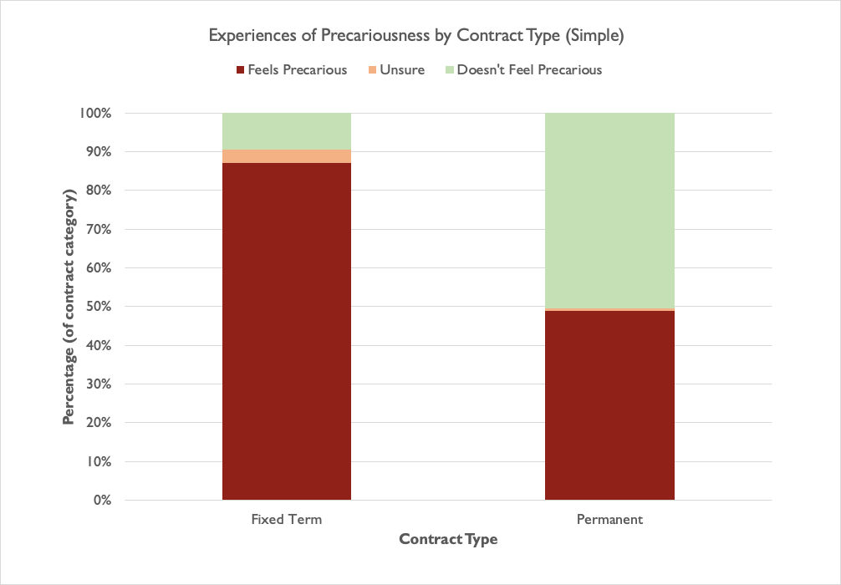
Survey Data:
Sample Demographics
Currently Experiencing Precariousness
Quick Takeaways:
Perhaps unsurprisingly, respondents employed on fixed term contracts were more likely to report currently feeling precarious than respondents employed on permanent contracts (87% to 49%)
BUT more unexpectedly, nearly half of all respondents who now hold permanent contracts also reported currently feeling precarious
Possibly a result of the recent wider instability in UK academia?

Slide 7
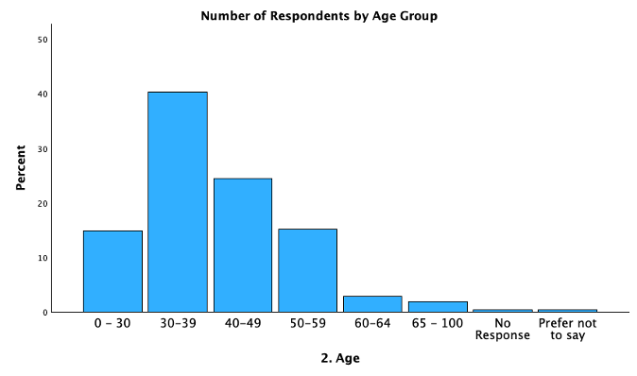
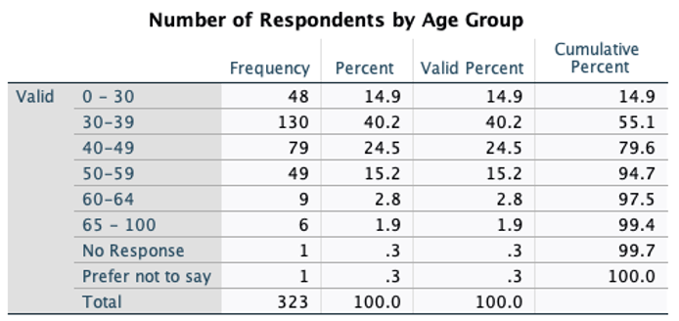
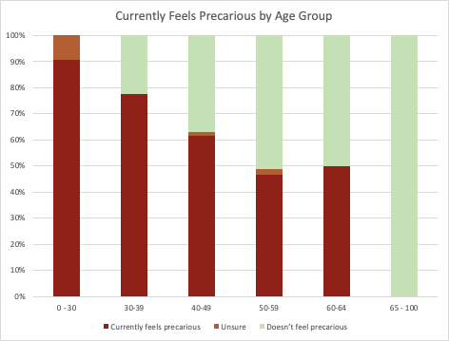
Survey Data:
Sample Demographics
Age & Experiences of Precariousness
Quick Takeaways:
Perhaps predictably, experiences of precarity reduce with age/career stage
Surprisingly high levels of precariousness still experienced at later stages in life (approx. 50%)
Need further analysis to establish how this corresponds with particular kinds of employment
Reflecting wider instability in UK academic landscape?
Data collected in 2023 - a lot has happened since…

Slide 8
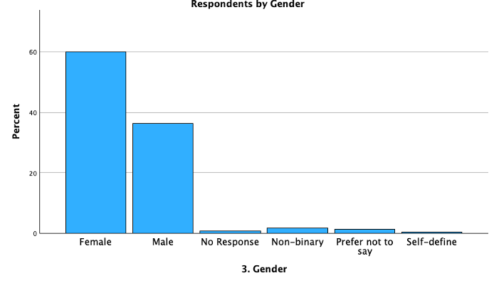
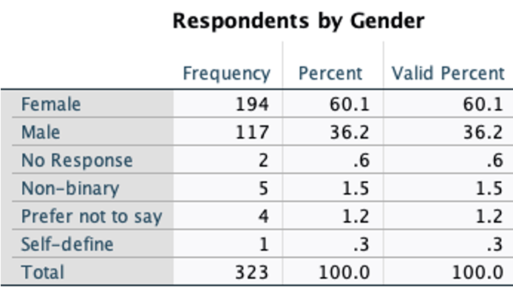
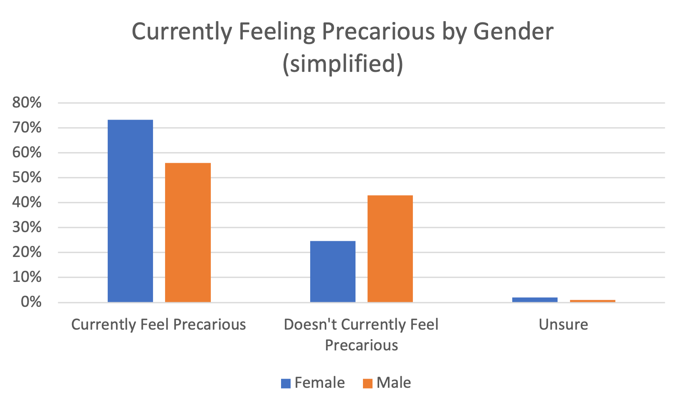
Survey Data:
Sample Demographics
Gender & Experiences of Precariousness
Quick Takeaways:
Non-binary, prefer not to say, and self-define categories too small to be statistically relevant. May learn more from the qualitative data
Significantly more women than men responded to the survey…
Significant disparities in experiences of precarity, dependent upon gender (73% of women report feeling precarious, compared to 56% of men)
Note:
Other gender categories removed (too few responses to be statistically significant)
Only applies to respondents who currently hold either a fixed term or permanent contract

Slide 9
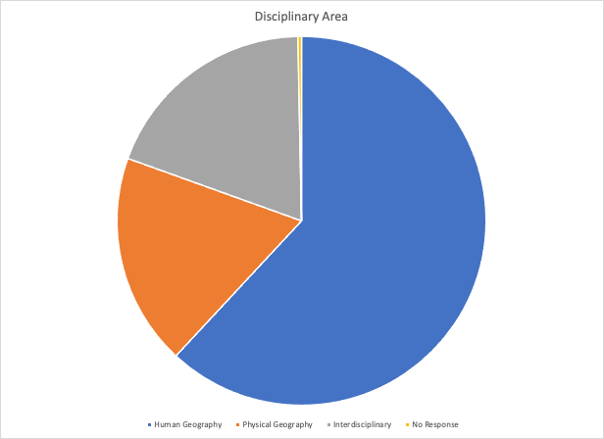
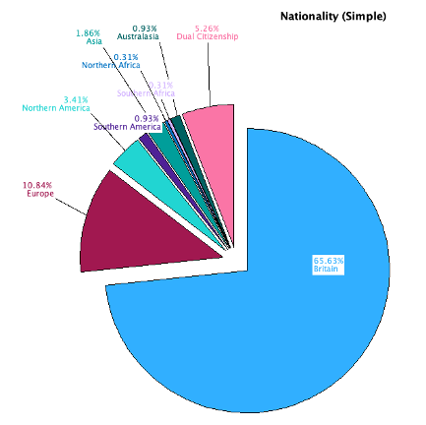
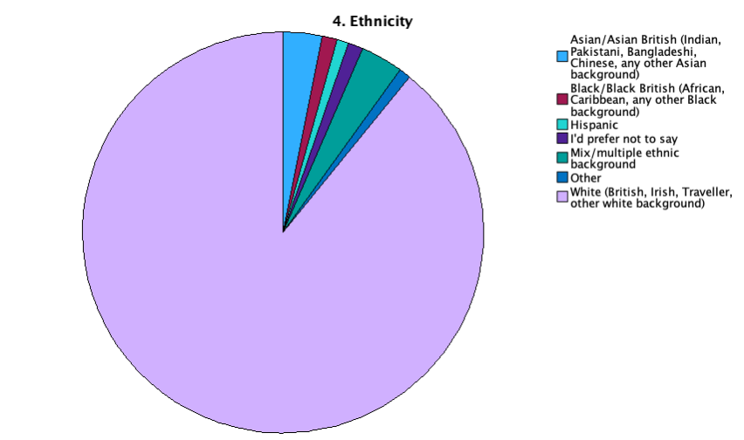
Survey Data:
Sample Demographics
Sample issues
Quick Takeaways:
Data skewed towards human geographers or geographers involved in some way with social research (81%)
Sample population heavily British or European, and mainly white
Doesn’t accurately represent the diversity of UK geography…

Slide 10
Key themes: Thinking with and the beyond the precarious ‘body’
‘Precarity is a deeply embodied experience that follows you everywhere’ (Survey participant 2023)
Academics commonly cast as ‘disembodied’ (Manzi et al. 2019)
Fleshless figures and ‘cultures of metrics’ overlook the ‘embodied nature of that which they count’ (Hawkins 2019)
Embodied experiences and responses to were precarity rife - fear, anxiety, stress, sense of jeopardy, hyper-vigilance
The neoliberal university is not only ‘written on the body’ (Mountz 2015) but cuts right through the nature of precarious working conditions

Slide 11
Key themes: Accounting for the complex temporalities and lasting effects of precarity
‘All I want is a stable job that will allow me to settle down and start planning my future’ (Survey Participant 2023)
Precarity is inherently temporal (Hughes 2021; Harris and Nowicki 2018)
Necessitates and imposes short-terminism and concerns about the future
Pace of work and ‘fitting the model’ of the idealised academic
Implications of ‘accelerated timelines’ (Mountz et al. 2015) on personal lives (e.g. family planning) - lives ‘constantly on hold’

Slide 12
Key themes: Taking seriously place and the materialities of precarity
‘Feeling uprooted or not being able to put down roots in any one place‘ (Survey respondent 2023)
Challenges of forming a sense of place in context of expectations of institutional mobility, research grant generated teaching buy-outs
Academia ‘projected as abstract, universal place’ (Manzi et al. 2019)
Lived realities of feelings of placelessness and rootlessness
Materialities of uprooted everyday life (e.g. housing precarity, gardens)

Slide 13
Key themes: Interrogating departmental cultures
‘I feel part of a conveyor belt of people’ (Survey respondent 2023)
Importance of reflecting on ‘academic cultures, alongside structural factors’ (Dyer at al. 2016)
Acknowledging precarity
(facilitating) talking about fixed-term contracts with colleagues
Spatialised hierarchies (e.g. names on doors, pigeonholes at the bottom)
Reflecting on where comfort and discomfort around precarity can be located and is produced

Slide 14
Discussants
Olivia Mason
Sage Brice
Aditi Das

Slide 15
Discussion
Questions for discussants
Guided questions

Slide 16
What next?
How might we respond to experiences shared in the survey?
Who do we want to bring to the table?
How/ where might we work to embed changes?
Best practice - sourcing, sharing, imagining?
Disseminating project findings?

Slide 17
2. Temporalities and scales: Evolving contexts and landscapes
Financial crisis: Institution-level and sectoral impacts?
Precarity across careers?

Slide 18
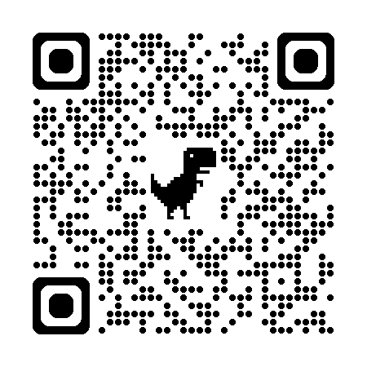
To get in touch with the States of Precarity team, visit: https://www.statesofprecarity.co.uk/ or use the QR code

Slide 19
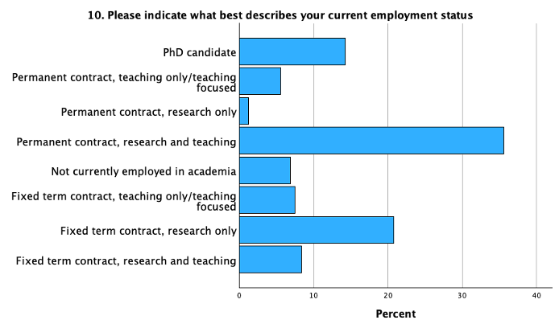
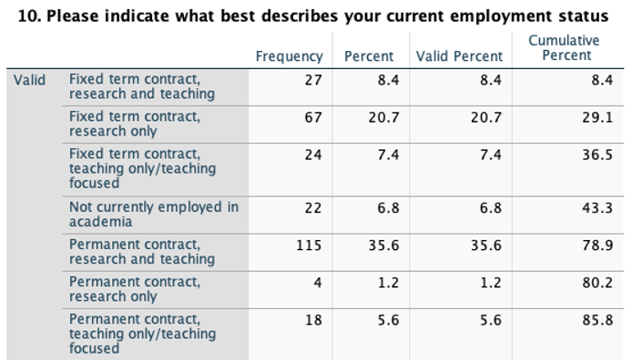
Survey Data:
Sample Demographics
Current Contract Type (Detailed)
Quick Takeaways:
Breakdown of contract types reveals a less even split between respondents in terms of contract types, with fixed term, research only; permanent contract, research and teaching, and PhD being the most popular categories
Too few respondents from the permanent contract, research only category to be able to make reliable inferences

Slide 20
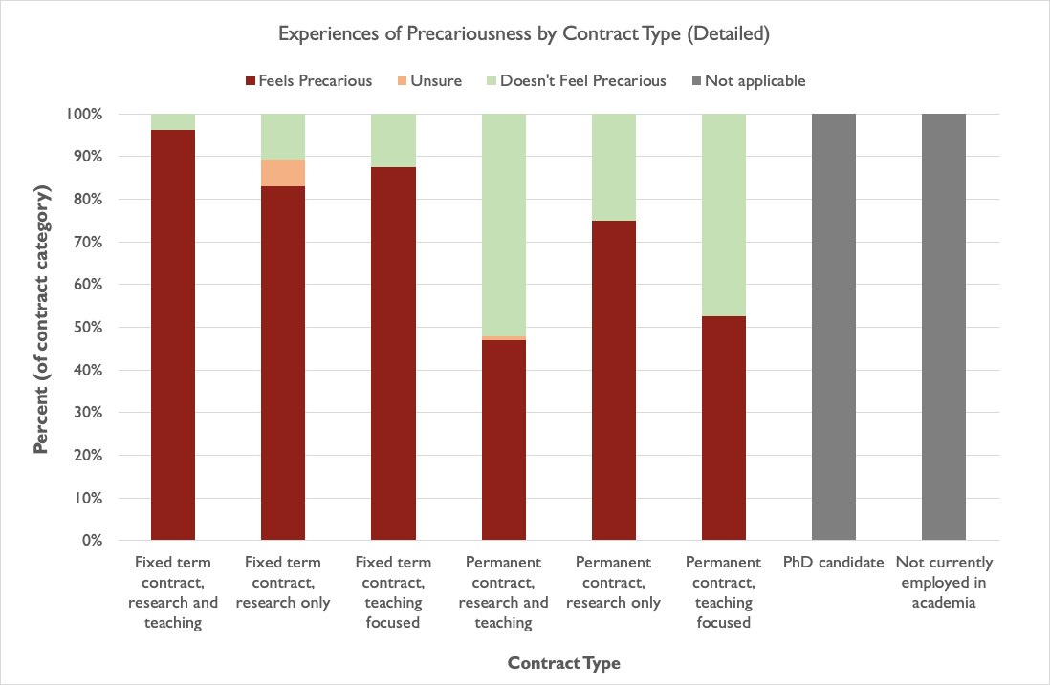
Survey Data:
Sample Demographics
Experiences of Precariousness
- By Current Contract Type (Detailed)
Only 4 cases
Quick Takeaways:
Greatest levels of precarity experienced by fixed term contract holders with a teaching component to their contract
Need more data across contract types, and to compare this against the qualitative data, to make further observations

